Slide 1
Street eMail Collection Presentation to WTWY
July 9, 2018

Slide 2
Objectives for Today’s Conversation
Explain
What We Did
Gathered data from MTA
Looked at the data, corrected issues
Created time series to analyze traffic
Identified most frequented Station
Mapped busiest stations with MTA Station details data
Superposed with Census / Demographic information (Gender, Revenue, Education)
Present Recommendations
Based on your hypothesis
Multiple Scenarii
Top candidate stations to place your street team
Discuss Next Steps
Review and improve existing models
Optimize the actions based on number of volunteers available
Implement best of class processes for email collection
Developed Communication Strategy and Plan for your team
.

Slide 3
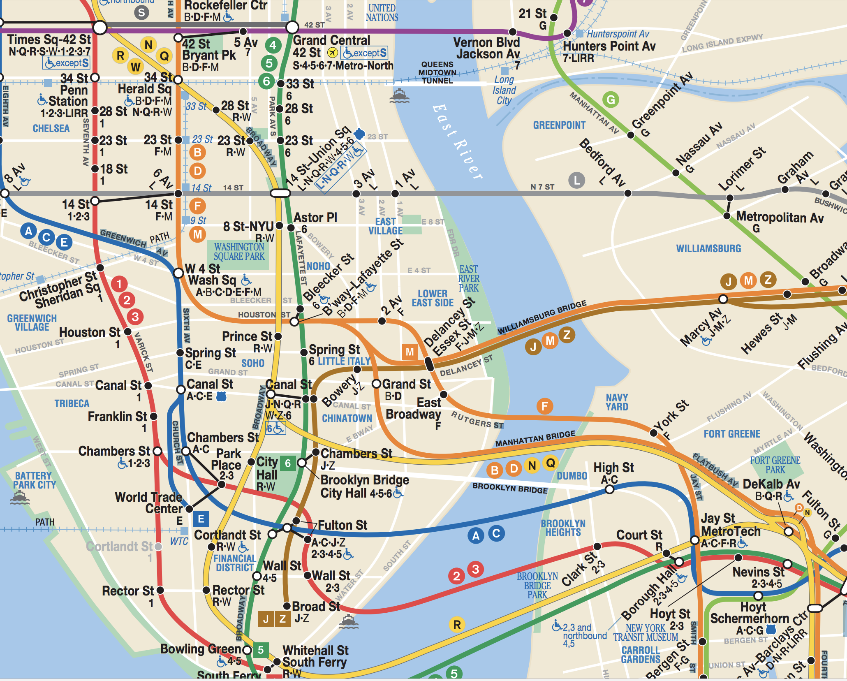
WTWY Annual Gala
Held at the beginning of the summer
Held in the lower East side
Street teams will be placed at entrance of subway stations to invite people to the gala
Participants will provide their email and be sent free tickets
GALA

Slide 4
Journey
These are proof of concepts - selected for initial trials of WTWY
Data
MTA traffic
High Transit Traffic.
Monday to Friday
MTA Station Details
(Latitude / Longitude)
ArcGIS / US Census
Median Income
College University
Level of Education
City Of New York
% of Women
Constraints
Manhattan Lower East Side
Data Merged On:
Station Name
Latitude / Longitude
GEOID
Assumptions
Traffic: Large Numbers to 0
Corrected Reverse Counts
Details: Stations that shared a division and Station name were deduped
Results
First Proposal
Based on traffic and location
Fulton Street
14 St Union Station
Grand Central
Second Proposal
Based on Weighted Averages
East Broadway
Grand Central
86th ST
Assumptions

Slide 5
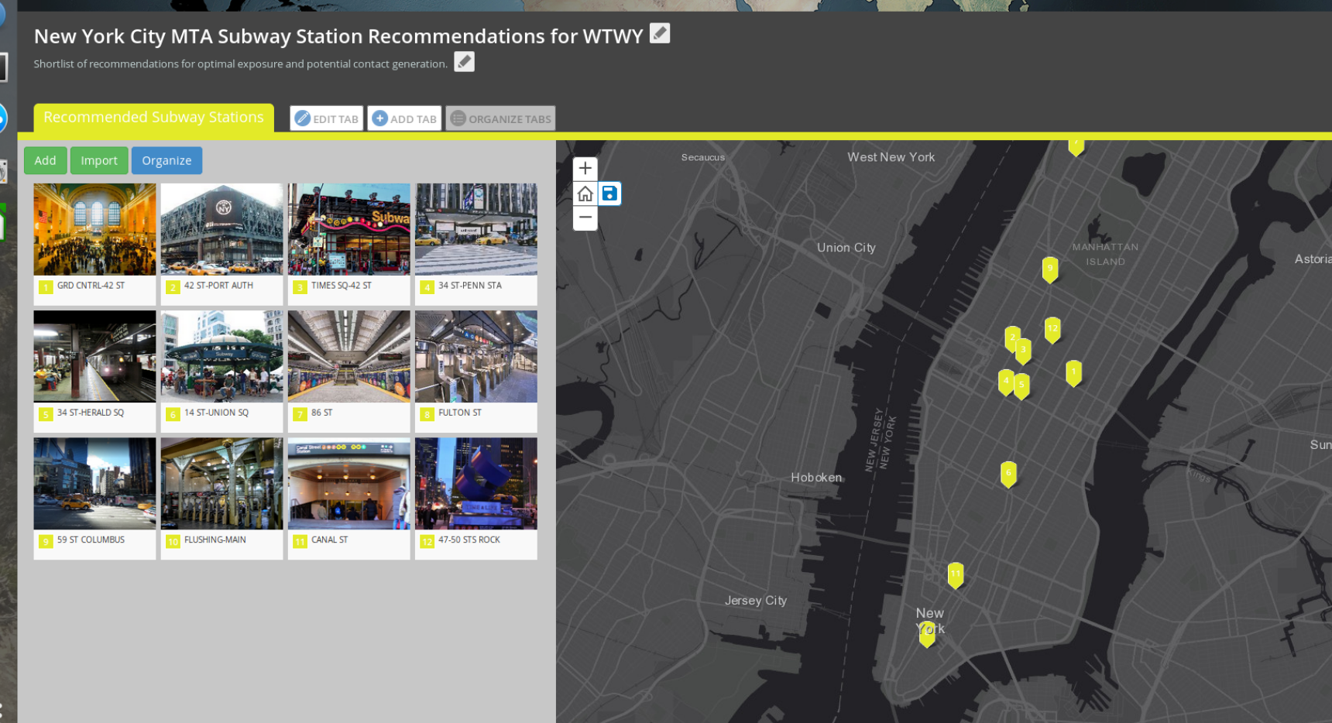
Top stations for our three week traffic data
Click Here

Slide 6
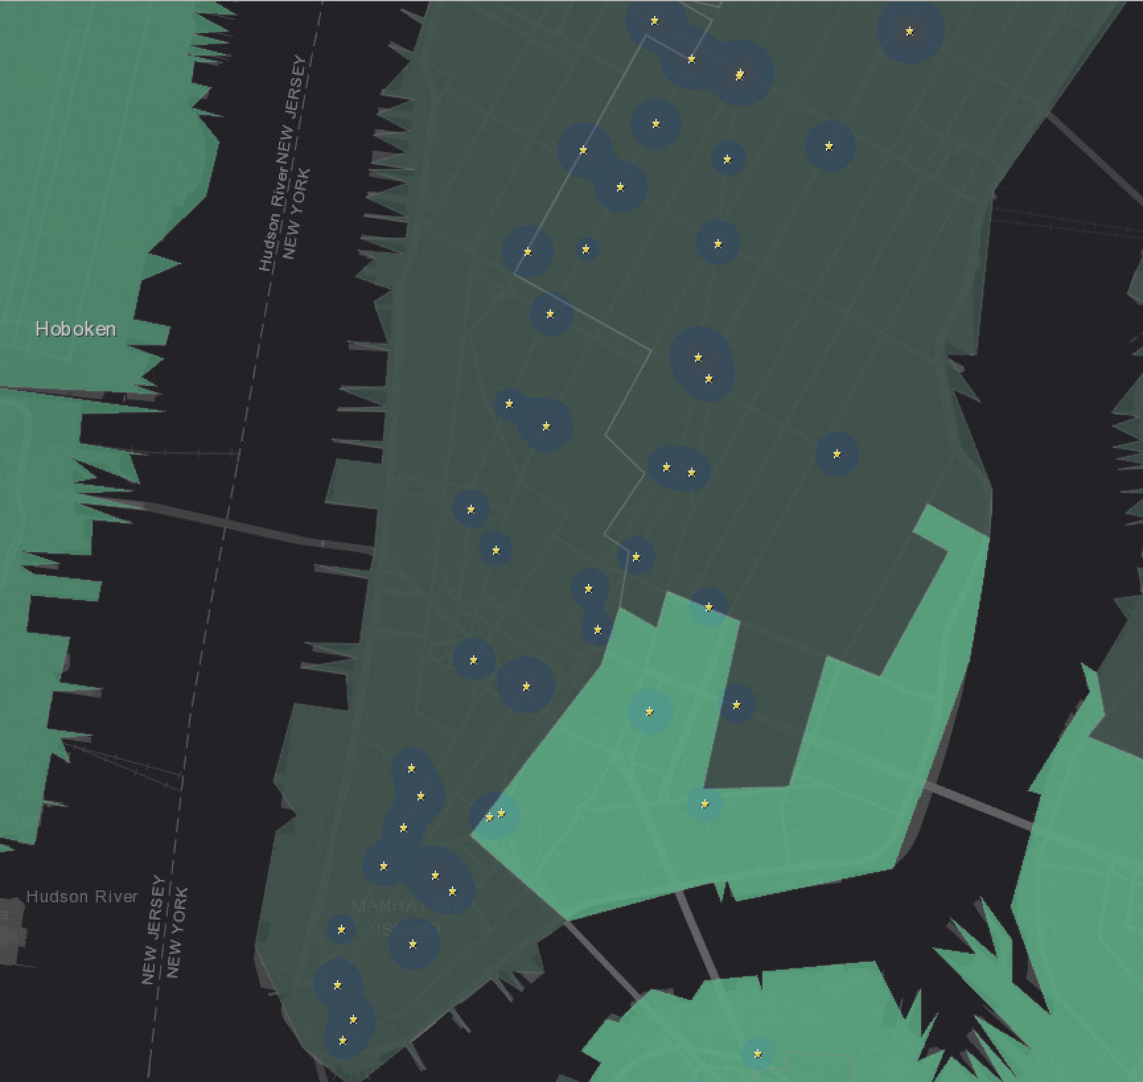
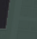

Consider Education level, Number of Women, Avg revenue linked to GEOID (Census Data)
First Avenue
8 ST NYU
14 ST
Bleeker Street
……
Subway Stations
Education level 2
Education level 1

Slide 7
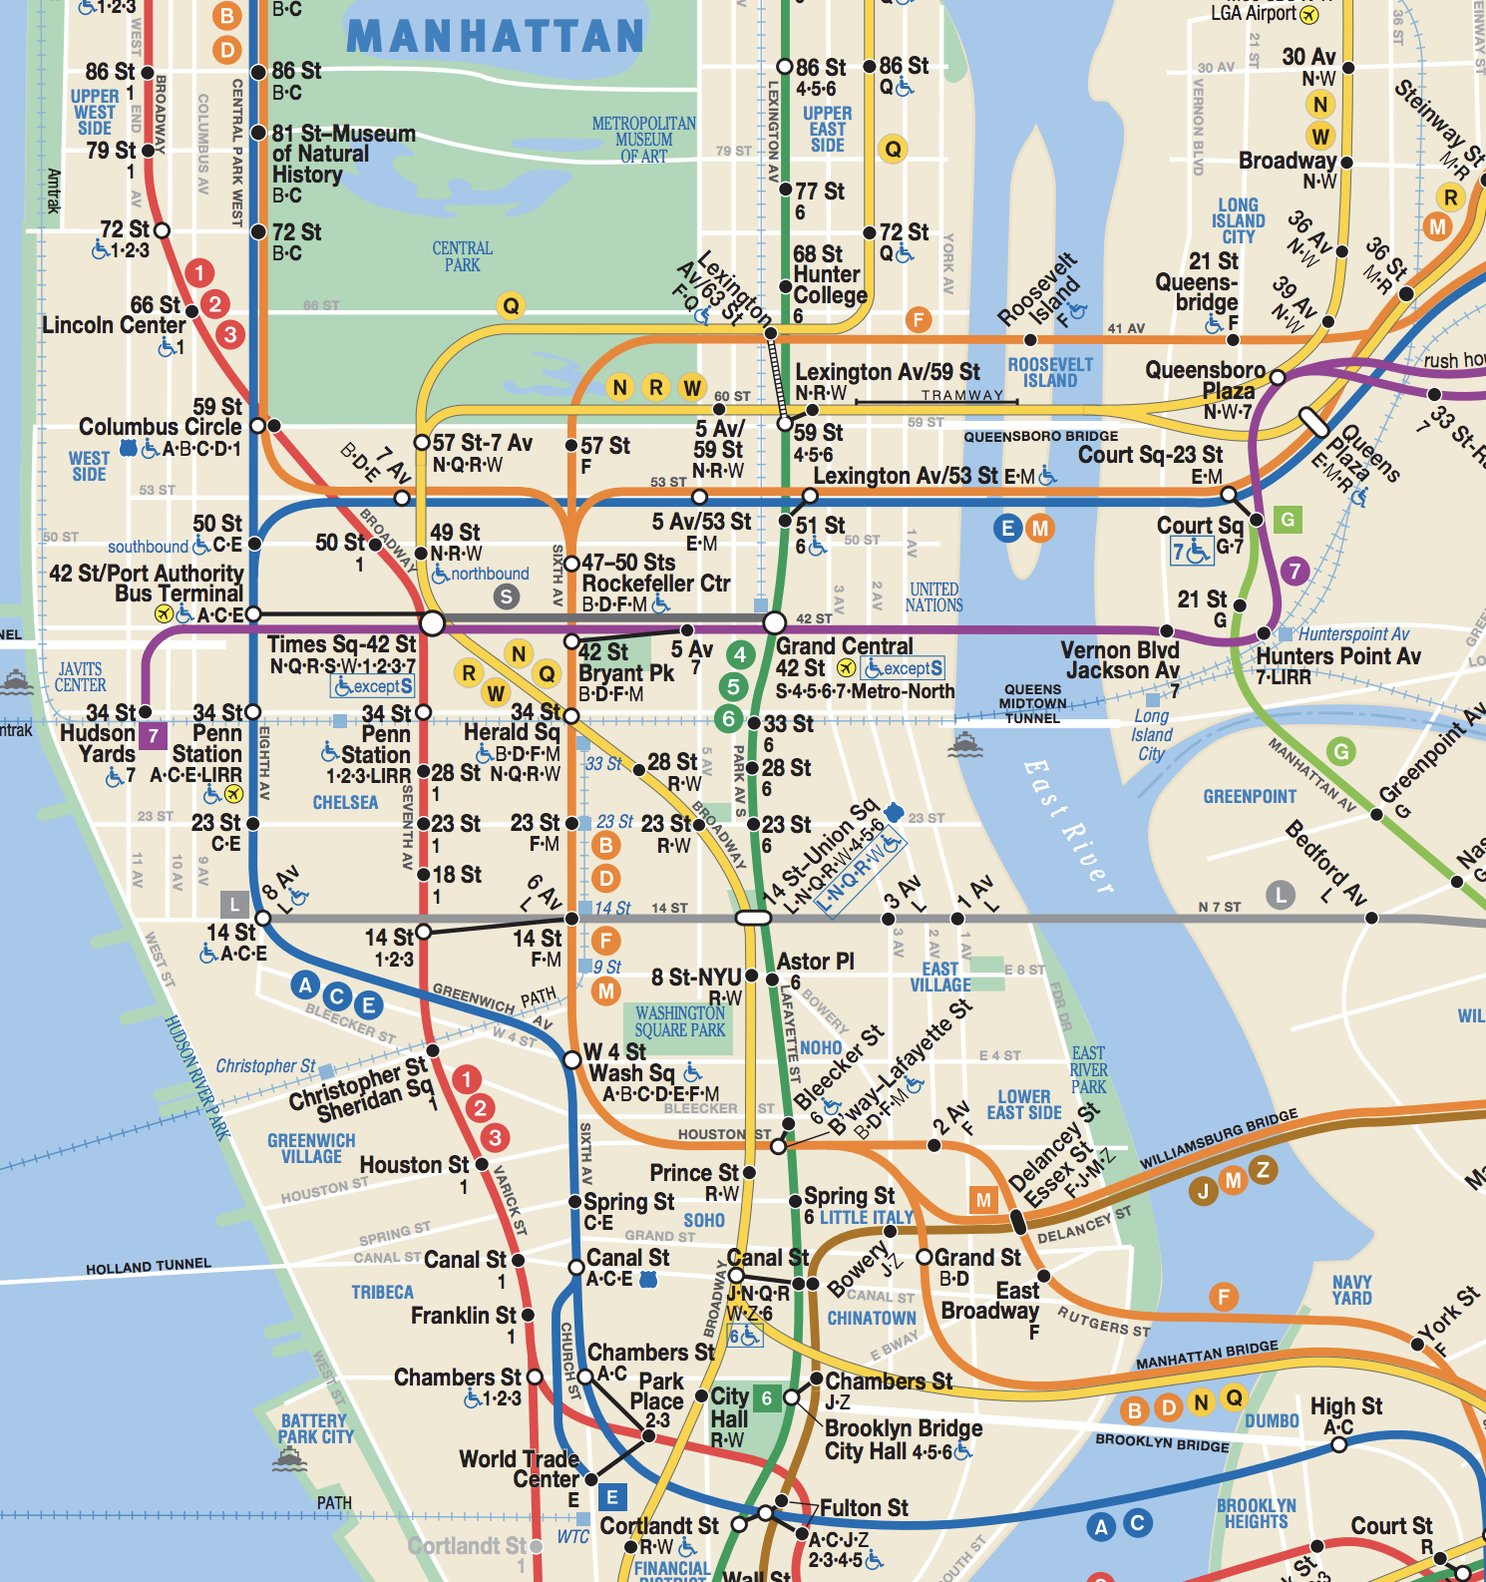
First Proposal
Based on traffic and location
Fulton Street
14 St Union Station
Grand Central
GALA

Slide 8
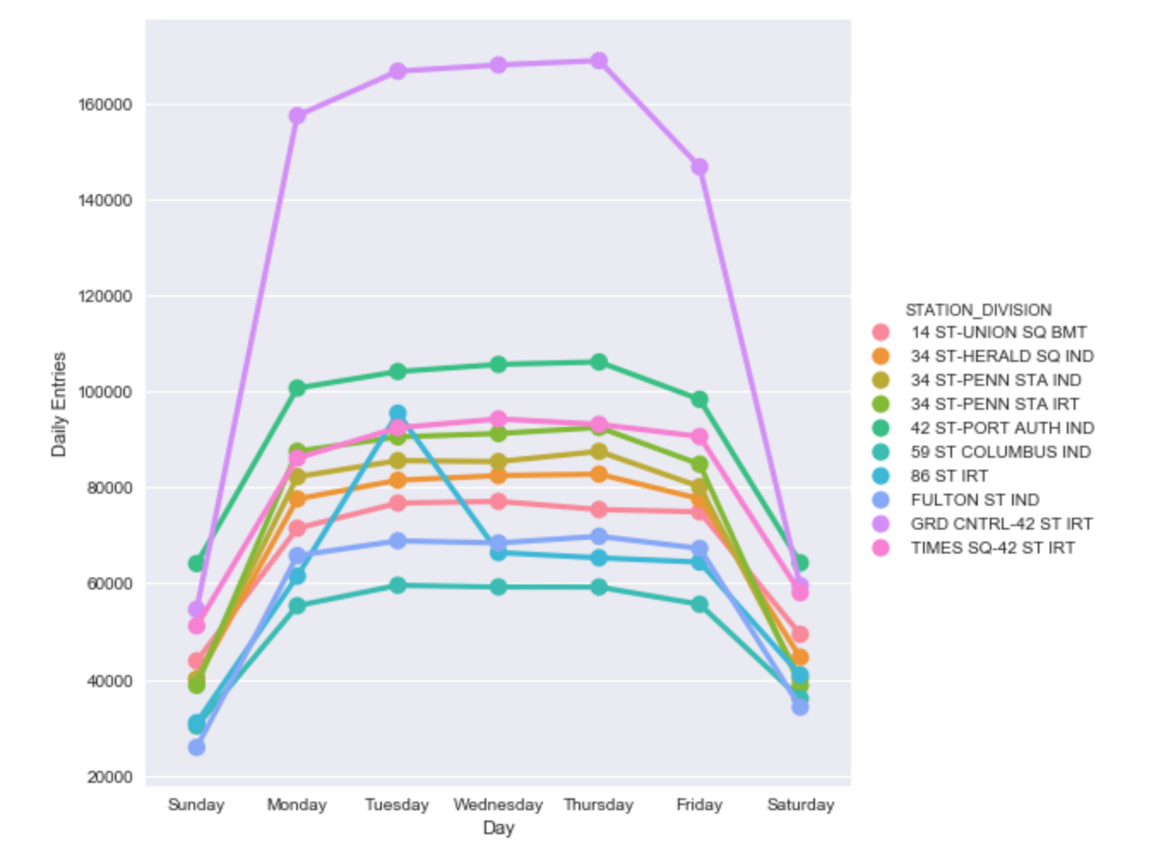
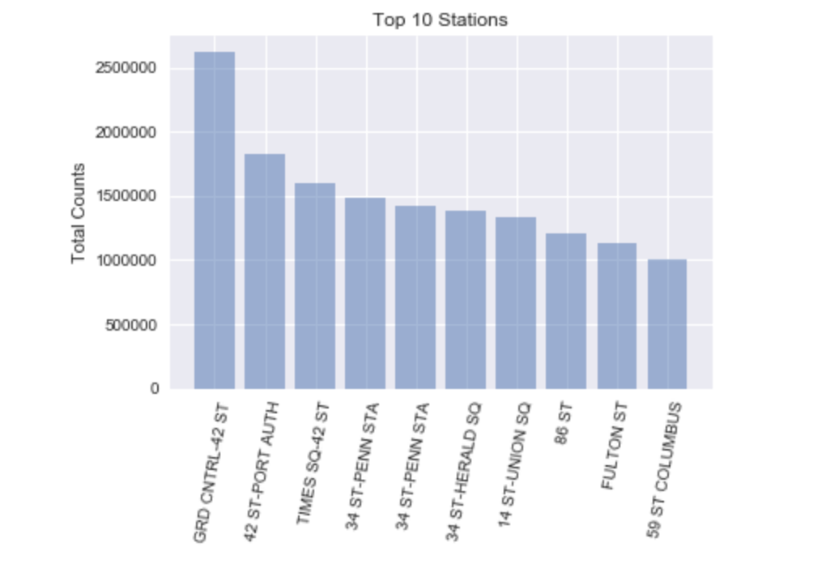
3 Week Traffic at the Top 10 stations

Slide 9
Recommendation Index (RI)
- Created a weighted scale based on each measure against the max value found across all stations.
RI = (
3 x (min distance to Gala / Distance to Gala)
2.5 x (# of Women / max # of Women)
2 x (# of Entries / max # of Entries)
1.4 x (# of Bachelor Degrees / max # of Bach. Degrees)
1.3 x (Avg household income / max avg household income)
1.1 x (# of Graduate Degrees / max # of Grad Degrees)
)* 100 / 11.3

Slide 10
Model Results
East Broadway Station
- #2 in distance to Gala, #2 in women population
Grand Central – 42nd St Station
- #1 in traffic, #1 in Income/Education
86th St Station
- # 3 in women population, # 7 in total traffic

Slide 11
Proposed Next Steps
Review and improve existing models
Optimize the actions based on number of volunteers available
Implement best of class processes for email collection
Developed Communication Strategy and Plan for your team

Slide 12
Appendix

Slide 13
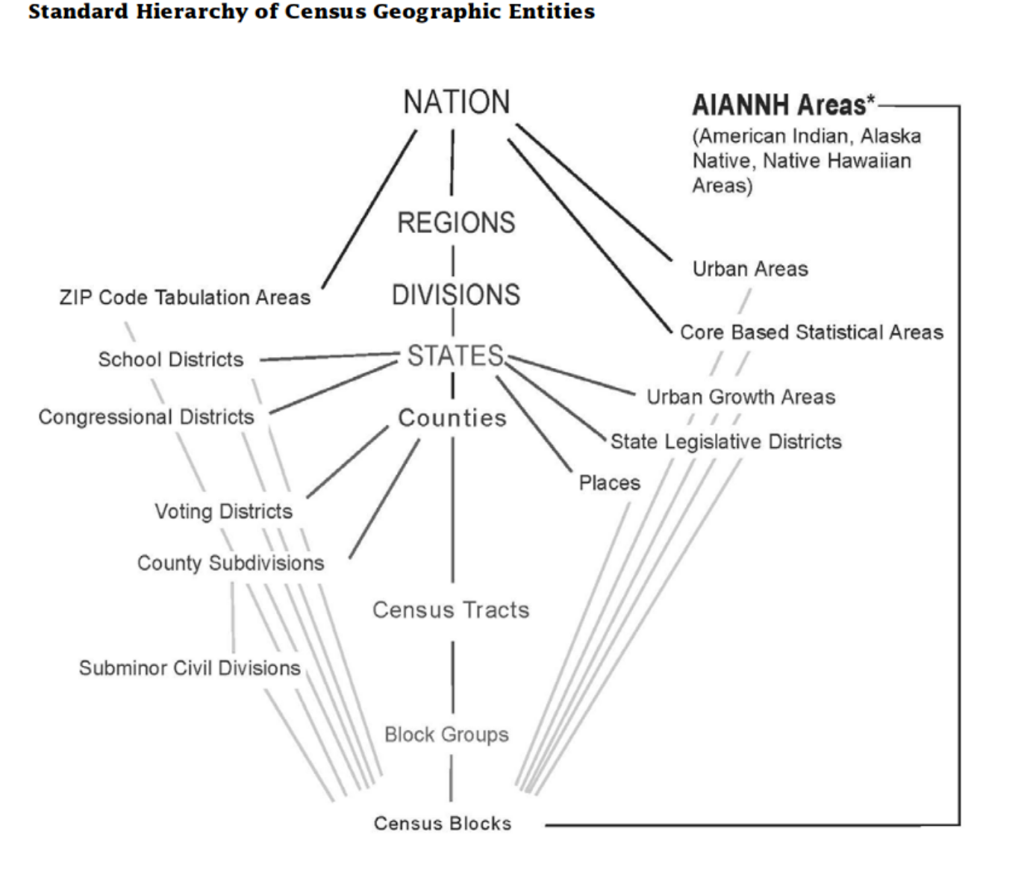
Geoid – Census Block

